Slide 1


KALLAM HARANADHA REDDY INSTITUTE OF TECHNOLOGY Department of CSE-(Artificial Intelligence & Machine Learning)
A project Titled on
Advanced Techniques in Rule Creation for Threat Detection
Presented by
Sk Zahida 208X1A4240
P.Manjunath 208X1A4254
T.Sasi Sekhar 208X1A4260
M.Sandeep Reddy 208X1A4252
Under the esteemed guidance of
Dr.K.Siva Rama Prasad ,Associate Professor
Dept CSE(AI&ML)

Slide 2
Index
Title Abstract Introduction Existing system Proposed system Methodology Requirements UML diagrams
Results with output Screens
Conclusion
Future Enhancement
Any queries

Slide 3
Advanced techniques in rule creation for threat detection
ABSTRACT
Brute force and dictionary attacks on password-only remote login services are now widespread and ever increasing. Enabling convenient login for legitimate users while preventing such attacks is a difficult problem, Automated Turing Tests (ATTs) continue to be an effective, easy-to-deploy approach to identify automated malicious login attempts with reasonable cost of inconvenience to users. In this paper we discuss the inadequacy of existing and proposed login protocols designed to address large scale online dictionary attacks (e.g., from a botnet of hundreds of thousands of nodes). We propose a new Password Guessing Resistant Protocol (PGRP), derived upon revisiting prior proposals designed to restrict such attacks. While PGRP limits the total number of login attempts from unknown remote hosts to as low as a single attempt per username, legitimate users in most cases (e.g., when attempts are made from known, frequently-used machines) can make several failed login attempts before being challenged with an ATT. We analyze the performance of PGRP with two real-world datasets and find it more promising than existing proposals.

Slide 4
INTRODUCTION
Online guessing attacks on password-based systems are inevitable and commonly observed against web applications identified password guessing attacks on websites as a top cyber security risk. SSH servers that disallow standard password authentication may also suffer guessing attacks, e.g., through the exploitation of a lesser known/used SSH server configuration called keyboard interactive authentication. However, online attacks have some inherent disadvantages compared to offline attacks: attacking machines must engage in an interactive protocol, thus allowing easier detection; and in most cases

Slide 5
EXISTING SYSTEM
However, users increasingly dislike ATTs as these are perceived as an (unnecessary) extra step; for usability issues related to commonly used CAPTCHAs.
Due to successful attacks which break ATTs without human solvers ATTs perceived to be more difficult for bots are being deployed. Account locking is a customary mechanism to prevent an adversary from attempting multiple passwords for a particular username.
Although locking is generally temporary, the adversary can mount a DoS attack by making enough failed login attempts to lock a particular account. Delaying server response after receiving user credentials, whether the password is correct or incorrect, prevents the adversary from attempting a large number of passwords in a reasonable amount of time for a particular username.
Traditional password-based authentication is not suitable for any untrusted environment (e.g., a key logger may record all keystrokes, including passwords in a system, and forward those to a remote attacker).

Slide 6
DISADVANTAGES
Break ATTs without human solvers ATTs (Automated Turing Tests).
Delaying server response after receiving user credentials.
when a certain number of failed attempts occur from a given machine,allowing more attempts without.
Do not prevent existing such attacks in un trusted environments.
Key logger may record all keystrokes, including passwords in a system,and forward those to a remote attacker.

Slide 7
METHADOLOGY
PGRP
Defenses against Online Password Guessing Attacks with PGRP Protocol Goals
Our objective for PGRP include the following:
The login protocol should make brute force and dictionary attacks ineffective even for adversaries with access to large botnets.
The protocol should not have any significant impact on usability (user convenience). For example: for legitimate users, any additional steps besides entering login credentials should be minimal. Increasing the security of the protocol must have minimal effect in decreasing the login usability.
The protocol should be easy to deploy and scalable, requiring minimum computational resources in terms of memory, processing time, and disk space.

Slide 8
PGRP WORKING PROCESS

Slide 9
PROPOSED SYSTEM
ATT challenges are used in some login protocols to prevent automated programs from brute force and dictionary attacks. Propose a new Password Guessing Resistant Protocol (PGRP), derived upon revisiting prior proposals designed to restrict such attacks.
A deterministic function (AskATT()) of the entered user credentials is used to decide whether to ask the user an ATT. To improve the security of the PS protocol, suggested a modified protocol in which ATTs are always required once the number of failed login attempts for a particular.
The proposed PGRP scheme is more restrictive against attackers than commonly used countermeasures. At the same time, PGRP requires answering fewer ATTs for all legitimate users, including those who occasionally require multiple attempts to recall a password.

Slide 10
ADVANTAGES
PGRP is the only protocol that avoids usability drawbacks of using cookies.
It reduces the number of ATTs that legitimate users must correctly answer so that a user with a valid browser cookie
PGRP requires answering fewer ATTs for all legitimate users.
It uses IP address and/or other methods to identify a remote machine.
In addition to optionally using cookies.

Slide 11
MODULES
Admin
Tracking Hacker
Send password
Block source IP

Slide 12
Admin
Registering with a new account

Slide 13
Tracking Hacker

Slide 14
Send password

Slide 15
Block source IP

Slide 16
Requirements
SOFTWARE REQUIREMENT: -
Front End/GUI Tool : Microsoft Visual studio 2005
Operating System : Windows 11
Language : JAVA
Back End : SQL SERVER 2000

Slide 17
HARDWARE REQUIREMENT: -
Processor : Pentium dual core
RAM : 1 GB or above
Hard Disk Drive : 80 GB or above
Monitor : 17” Color Monitor

Slide 18
UML DIAGRAMS
CLASS DIAGRAM
USE CASE DIAGRAM
SEQUENCE DIAGRAM
COLLABORATION DIAGRAM
ACTIVITY DIAGRAM

Slide 19
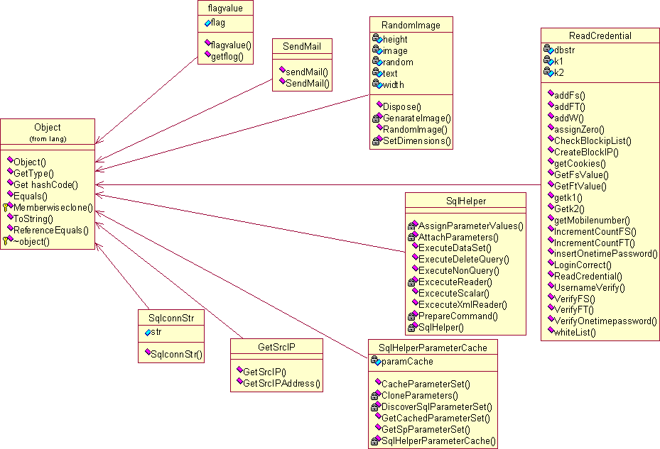
1.CLASS DIAGRAM

Slide 20

2.USE CASE DIAGRAM
Enter Url
Login
Admin
User
Track Hacker
Send SMS

Slide 21
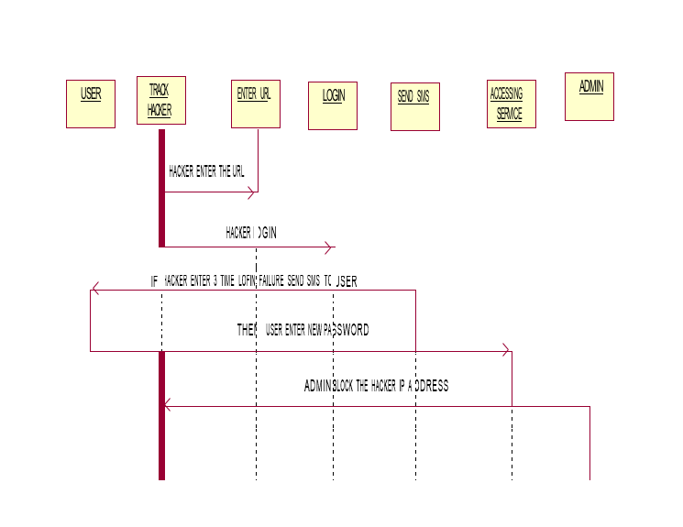
3.SEQUENCE DIAGRAM

Slide 22
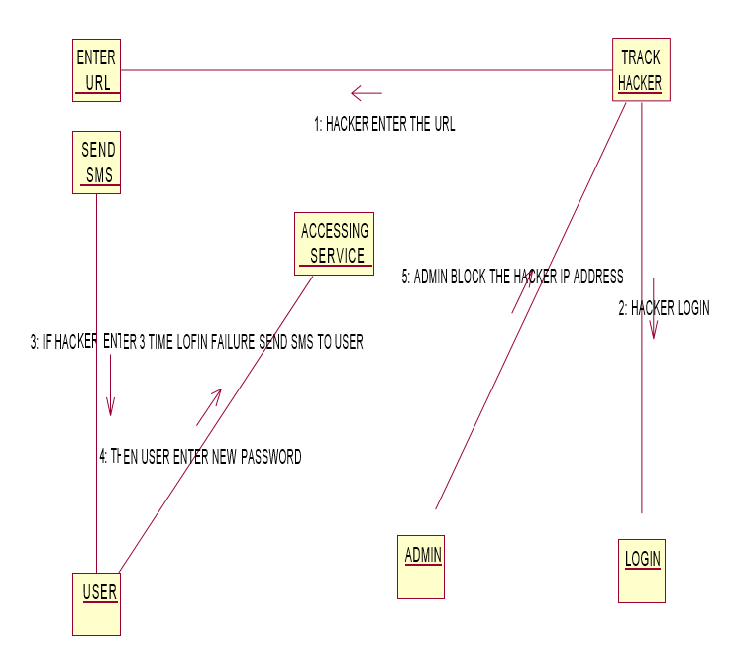
4.COLLABORATION DIAGRAM

Slide 23
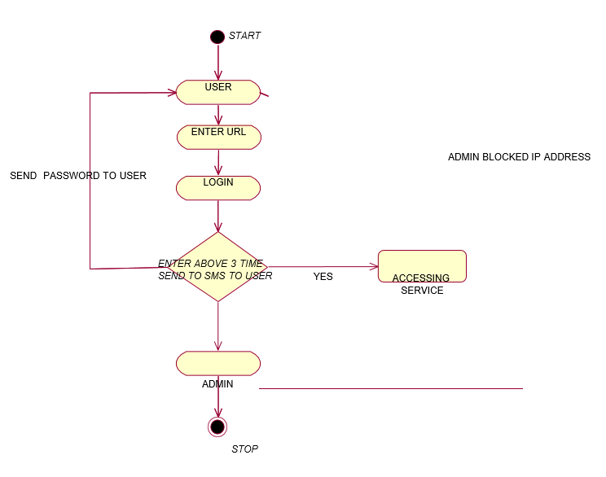
5.ACTIVITY DIAGRAM

Slide 24
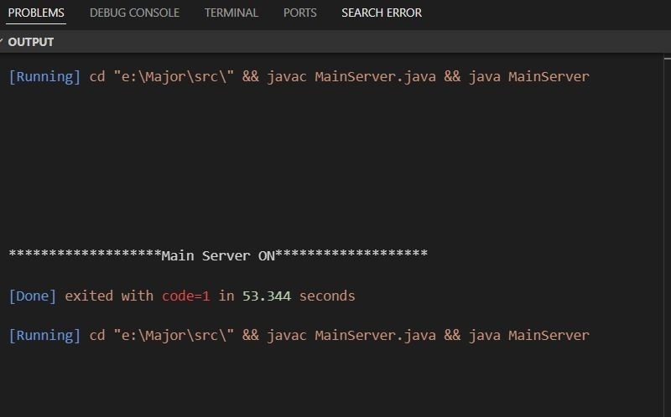
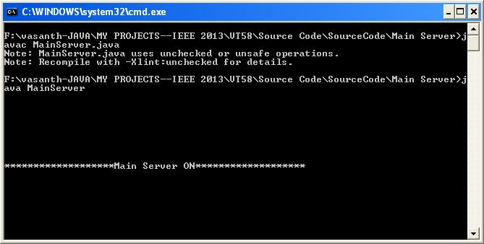
Results with output Screens

Slide 25
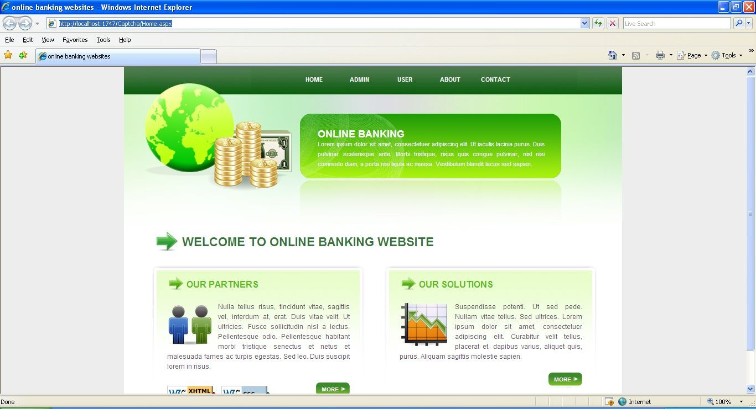
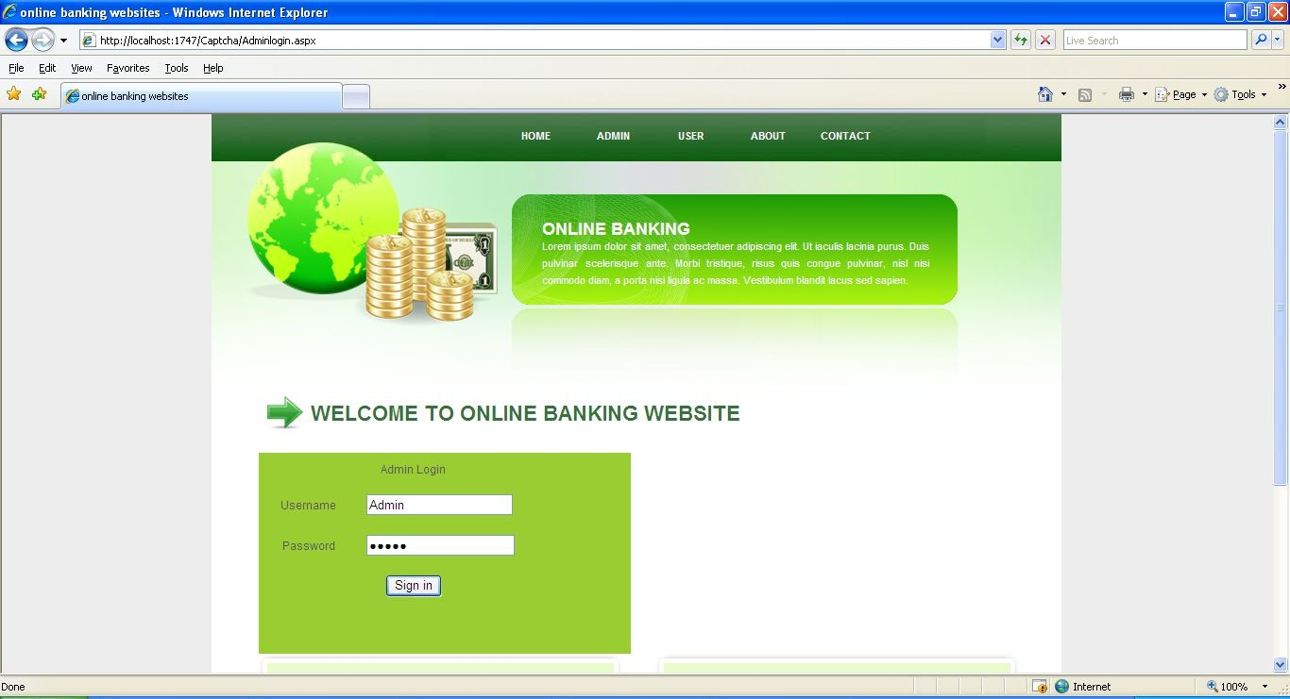
output Screens
Home Page
About Admin Page

Slide 26
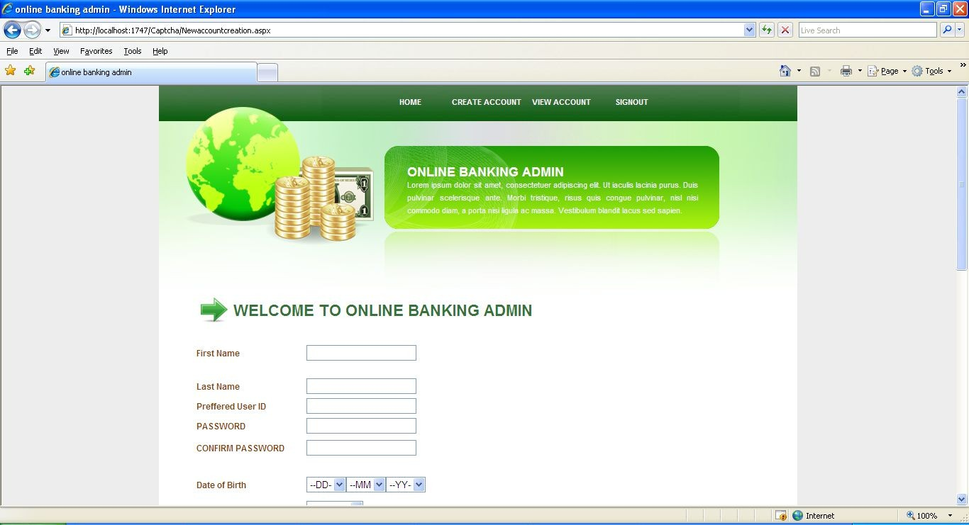
Account Creation Page

Slide 27
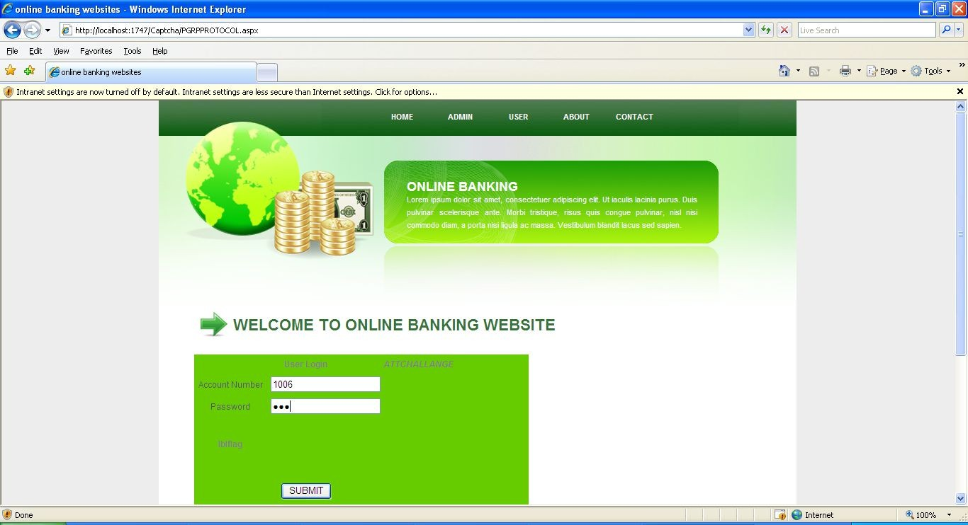
User Login Page

Slide 28
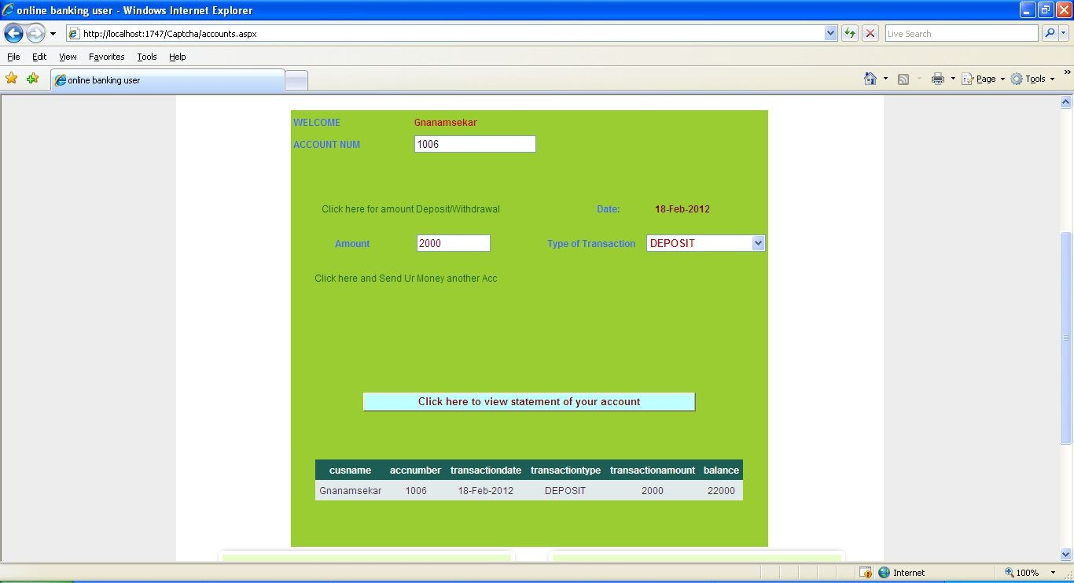
Transaction Page

Slide 29
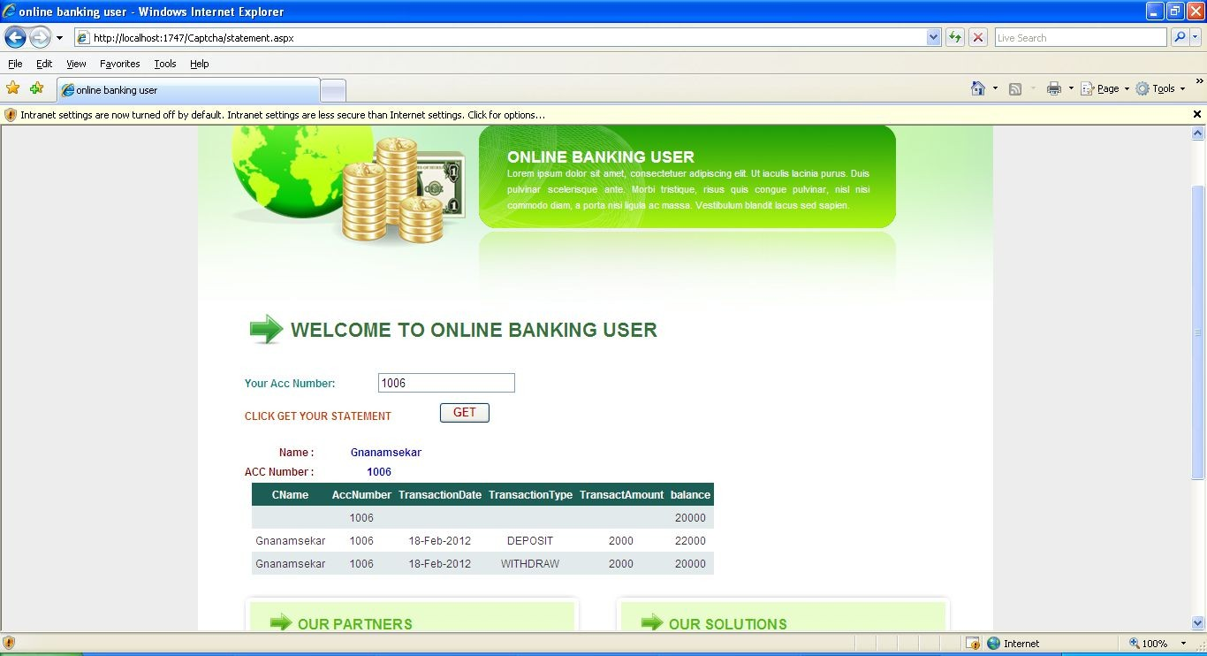
Bank Statement

Slide 30

Conclusion
Now a days a lot of cyber attacks are increased widely ,to reduce those the ATT is used with PGRP. PGRP is more restrictive against brute force and dictionary attacks while safely allowing a large number of free failed attempts for legitimate users and doesn’t allow a large number of free failed attempts for non-legitimate users.

Slide 31
FUTURE ENHANCEMENTS
Looking ahead, several avenues for future work can further enhance the impact and capabilities of our project:
Enhanced Rule Creation Techniques
Integration with Threat Intelligence Platforms
Behavioral Analysis and User Entity Behavior Analytics
Automated Response and Orchestration
Scalability and Performance Optimization
Compliance and Regulatory Requirements
Collaborative Threat Intelligence Sharing
Adaptive Learning and Self-Learning Capabilities

Slide 32
ANY QUERIES I DON’T HAVE ANY IDEA REGARDING THIS I WILL EDIT IN COLLEGE BY ASKING SIR

Slide 33


